Slide 1
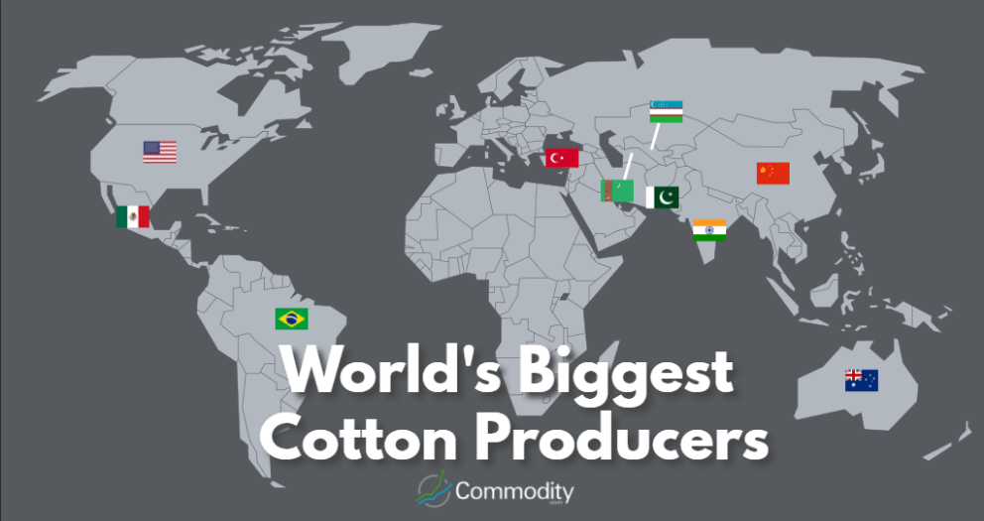
Geography Knowledge Organiser:
At the end of this unit, I will be able to…
Prior Knowledge
Impact of rising temperatures on sea levels and ice cap. What impact can humans have on reducing this impact? know the processes of economic activity (including trade links – deforestation – reasons why and what it is used for. Fair trade of coffee and chocolate).
know what sustainable fashion is and how some companies are managing to produce it.
explain some of the processes, which contribute to climate change and discuss the possible impact of atmospheric change on the survival of living things.
Key Physical Features
describe how the interdependence of countries affects levels of development, considering the effects on people’s lives.
Cotton is a plant that needs a long frost-free period, a lot of heat and plenty of sunshine.
It prefers warm and humid climate.
During active growth, the ideal air temperature is 70 to 100°F (21-37°C).
The average cotton plant can survive in temperatures up to 110°F (43°C) for short periods without great damage, but this also depends on the humidity levels.
In order to cultivate cotton plants successfully, should not be frequent rainfalls during the maturing (summer) and during the days of harvest (during autumn).
Cotton can grow in almost all well drained soils.
Location
Scary fact: To put cotton production into context – enough cotton is produced per year right now to make 29 t-shirts for every person on Earth.
Key human features
The most wide-spread profitable non-food crop in the world.
Provides an income for more than 250 million people world-wide
Employs nearly 7% of all labour in the developing world
Approximately half of all textiles are made from cotton.
Cotton’s most prominent environmental impacts result from the use of agrochemicals (especially pesticides), the consumption of water, and the conversion of habitat to agricultural use.
Diversion of water and its pollution by cotton growing has had severe impacts on major ecosystems.
Notes:
Does this sound much different to what we already do?
How does this make us look at evidence gathering differently?
What are the implications for you and your teams?

Slide 2
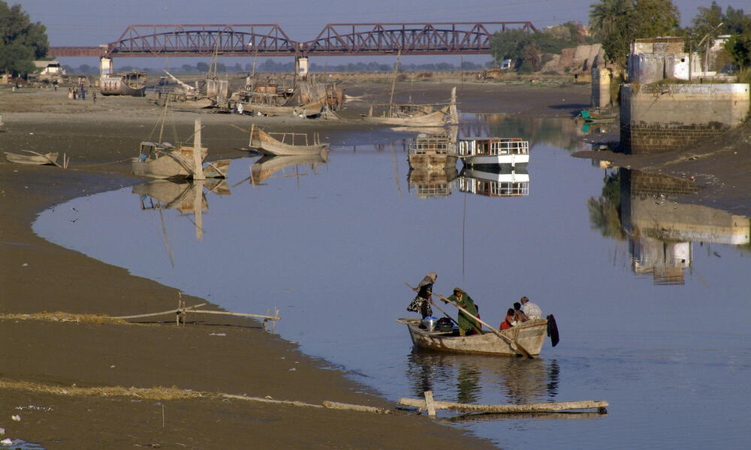
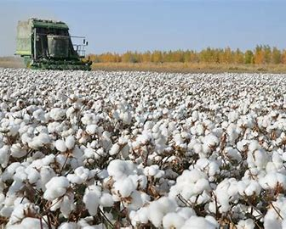
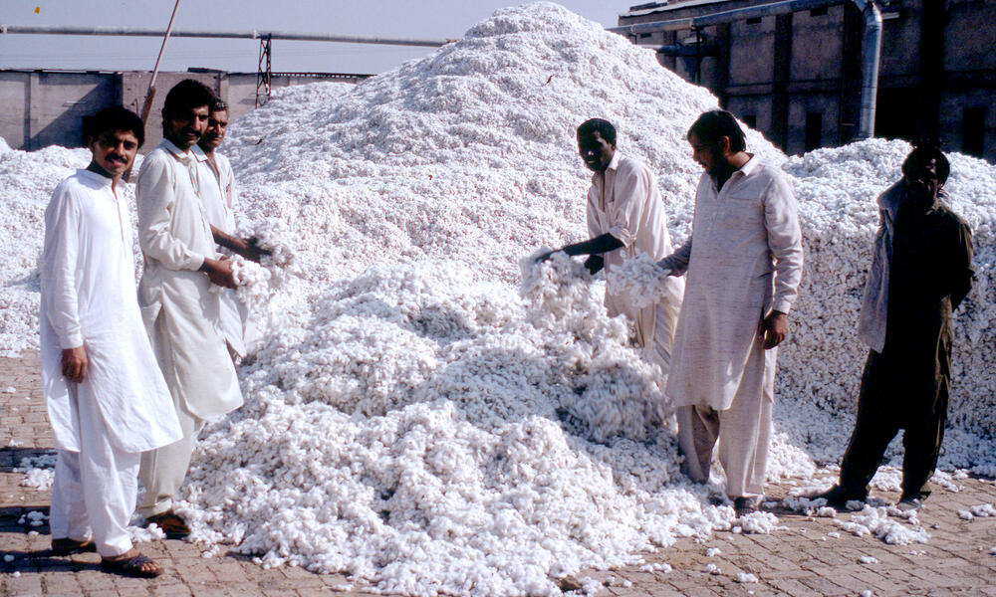
Geography Knowledge Organiser:
Key information
Cotton is a plant fibre that grows in shrub plants. The fibres of this soft and fluffy plant are used to manufacture a variety of fabrics and textiles, ranging from lightweight laces to thick-piled velveteen. Cotton fabrics are frequently used for clothing, furnishings and for industrial uses. It is commonly used to make clothes as it is very breathable; it absorbs and releases moistures quickly.
Key vocabulary
Source | Where you get something from
Environmental impact | The impact you have on the environment
Consumption | The using up of a resource
Textile | A type of cloth or woven fabric
Synthetic | Man-made from chemicals
Sustainable | conserving an ecological balance by avoiding depletion of natural resources
Landfill | A place to dispose of refuse and other waste material by burying it and covering it over with soil, especially as a method of filling in or extending usable land
Developing World | Countries or the parts of the world that are poor and have few industries
Sweatshop | A factory or workshop, especially in the clothing industry, where manual workers are employed at very low wages for long hours and under poor conditions.
Social injustice | When someone does not have the same access to their rights and privileges due to discrimination and occurs when a person, people, or groups of people are treated unfairly.
97% of the water from the Indus River goes to producing crops.
Hanging washing outdoors reduces your carbon footprint by a third!
A cotton harvester at work
Notes:
Does this sound much different to what we already do?
How does this make us look at evidence gathering differently?
What are the implications for you and your teams?

